Slide 1
Picard-electrical
Chiwei Peng
Week 10
9/5/2017

Slide 2
My Tasks
Finger sensor--collect and recognize finger print
Servo locking--have the correct response for the fingerprint and the pill box
Buttons--check the condition of the pusher and give reports
Battery--supply power for the R-pi
LCD Screen--display all the signals and reports made by any change to the pill bottle and conditions of the device

Slide 3
week | progress
1 | leaned what the previous team has done before; learned about my tasks and made a simple plan.
2 | learned Html, Javascript, Css in one week; practiced several ways to connect the Raspberry Pi such as SSH, Putty, Remote Desktop Connection and touch screen connection.
3 | practice Html, Javascript, Css by using them to create the first web page of the interface; studied the datasheet of the Fingerprint sensor and understood its command line.
4 | using only Html, Javascript, Css to build a dozen of simple web pages that we need; studied some code of the Fingerprint sensor from Github.
5 | learned Node.JS and the framework of Electron; used node.js to control the servo connected with the Raspberry Pi; used Electron to open the web pages.
6 | managed to use Node.JS in Electron; practiced Node.js to read files, and send command to use Python by working with Jarvis.
7 | integrated the servo function into interface; added password function into interface; built functions to record the usage of pills.
8 | completed the usage recording function; designed and soldered a simple circuit to create a button for the device.
9 | managed to interact with the database Mysql, including sending data, reading data and displaying data; optimized the User interface and integrated with the mechanical part.
10 | prepared my work for future development and concluded my contribution.

Slide 4
Results
Finger sensor—not done, problems
Servo locking—completed
Buttons—half done
Battery— no results
LCD Screen—mostly done

Slide 5
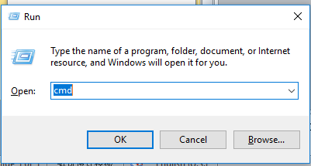

User Interface
1. Connect R-Pi with computer using an Ethernet cable
(touch screen can be connected before this and used meanwhile)
2. Run cmd on computer(windows+R) and then run “arp –a”
3.one of the address belongs to the R-Pi, use it in Remote Desktop Connection

Slide 6
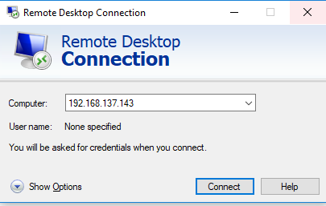
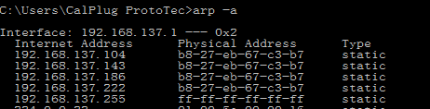
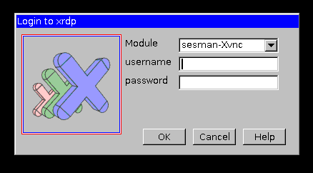
User Interface
To use RDC, make sure the system is installed with xrdp(use putty to connect the same internet address to install: sudo apt-get install xrdp)
4. username：pi password: raspberry

Slide 7
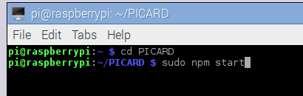
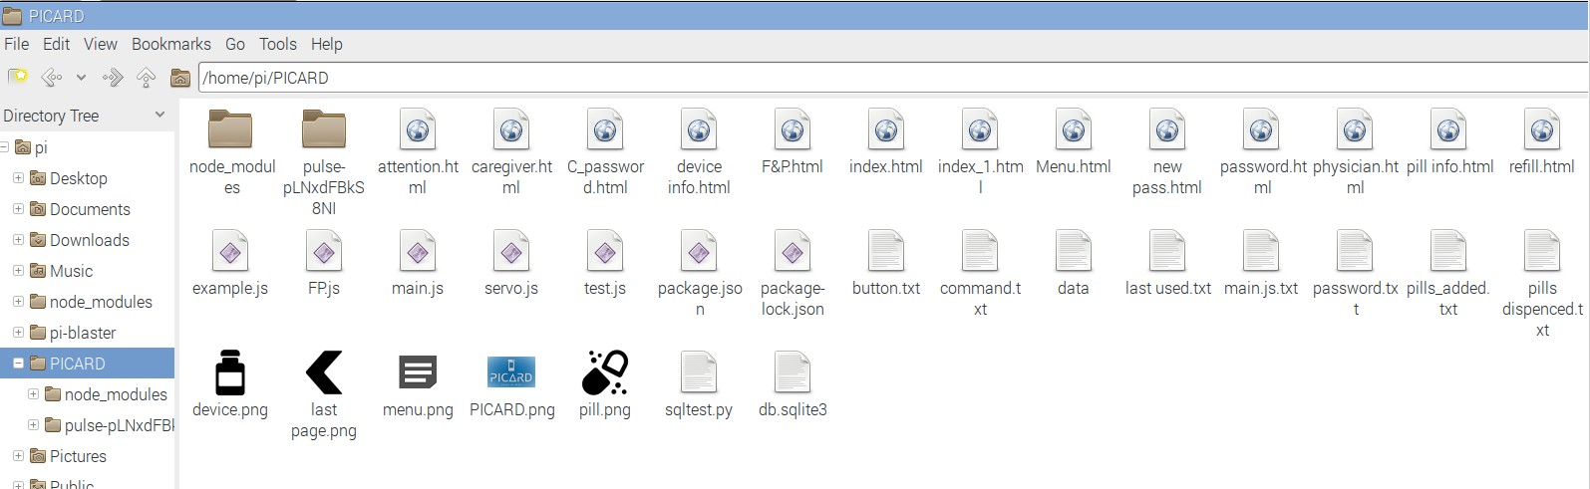
User Interface
5. go to Terminal, run: cd PICARD
6. then run： sudo npm start
(see video ‘picard’ about the core function)
7.to exit, use ‘ctrl+c’ in terminal
8.both touch screen and the computer can display UI at the same time
Project file:

Slide 8
FP sensor
First connect to the Pi
go to Terminal, run: cd PICARD
then run： sudo node FP (problem : no result from console)
button
First connect circuit to the Pi
go to Terminal, run: cd PICARD
then run： sudo node button
Then conduct test using the two wires without tags

Slide 9
Servo
Connection with the Pi :
red : 5V brown : GND orange : GPIO17
Pulsewidth：
1600：middle (where servo should be when not moving)
100=10 degrees
range:500-2500
Node_modules
Set node version, run: n v(version), example: n v6.9.0

Slide 10
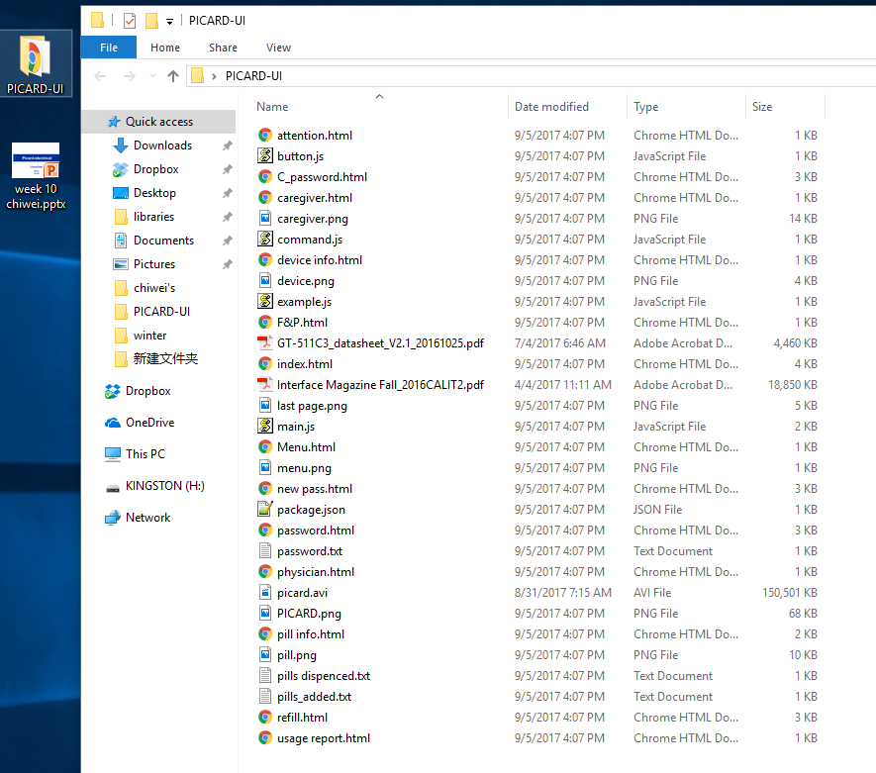
Code and other files

Slide 11
Thanks to you all!

